Slide 1





Home
Services
Features
About Us
Contact
Introduction to
fuel cost
estimator
COURSE- INTRODUCTION TO PROBLEM SOLVING AND PROGRAMMING IN PYTHON
SUBMITTED BY - Adwita Shrivastava REGISTRATION NUMBER - 25BCE10550
COURSE- INTRODUCTION TO PROBLEM SOLVING AND PROGRAMMING IN PYTHON SUBMITTED BY - MAHI UDASI REGISTRATION NUMBER - 25BCE10756

Slide 2

Home
Services
Features
About Us
Contact
problem definition
Transportation costs are increasing, and many people need a simple way to estimate how much fuel and money a trip will require.
Manually calculating distance, mileage, fuel needed, and cost can be time-consuming and error-prone.
Deep Learning (DL)
A Fuel Cost Estimator App helps users easily calculate the total fuel required and the expected cost for any journey.

Slide 3

Home
Services
Features
About Us
Contact
Objectives of the Project
The project aims to:
Estimate fuel required for a trip
Estimate cost based on fuel price
Help users plan trips more efficiently
Provide quick and accurate calculations
Improve budgeting for travel

Slide 4
✔ Functional Requirements
Take distance (km) from user
Take vehicle mileage (km per litre)
Take fuel price per litre
Calculate litres of fuel needed
Calculate total trip cost
Display final result
Home
Services
Features
About Us
Contact
Requirements

Slide 5
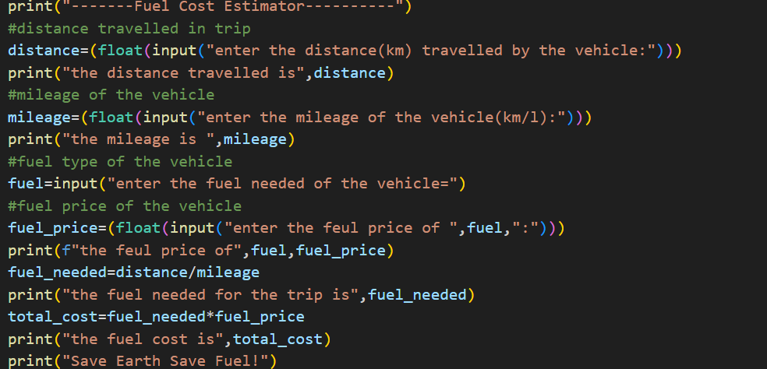
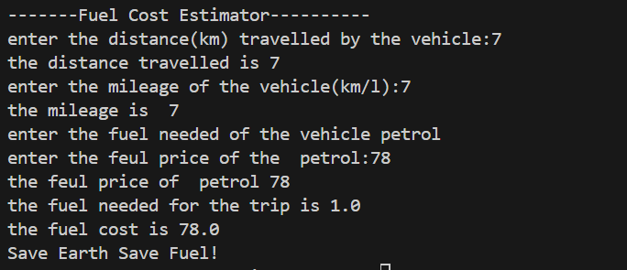
Home
Services
Features
About Us
Contact

Slide 6




Home
Services
Features
About Us
Contact
Thank You
Creacrecre3acrea
References
#google
#vityarthi
+123-456-7890
www.reallygreatsite.com
hello@reallygreatsite.com
123 Anywhere St., Any City, ST 12345

